Slide 1
An introduction to control
Lecture 14

Slide 2
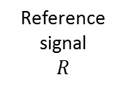
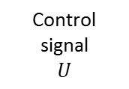
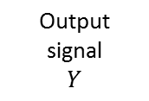


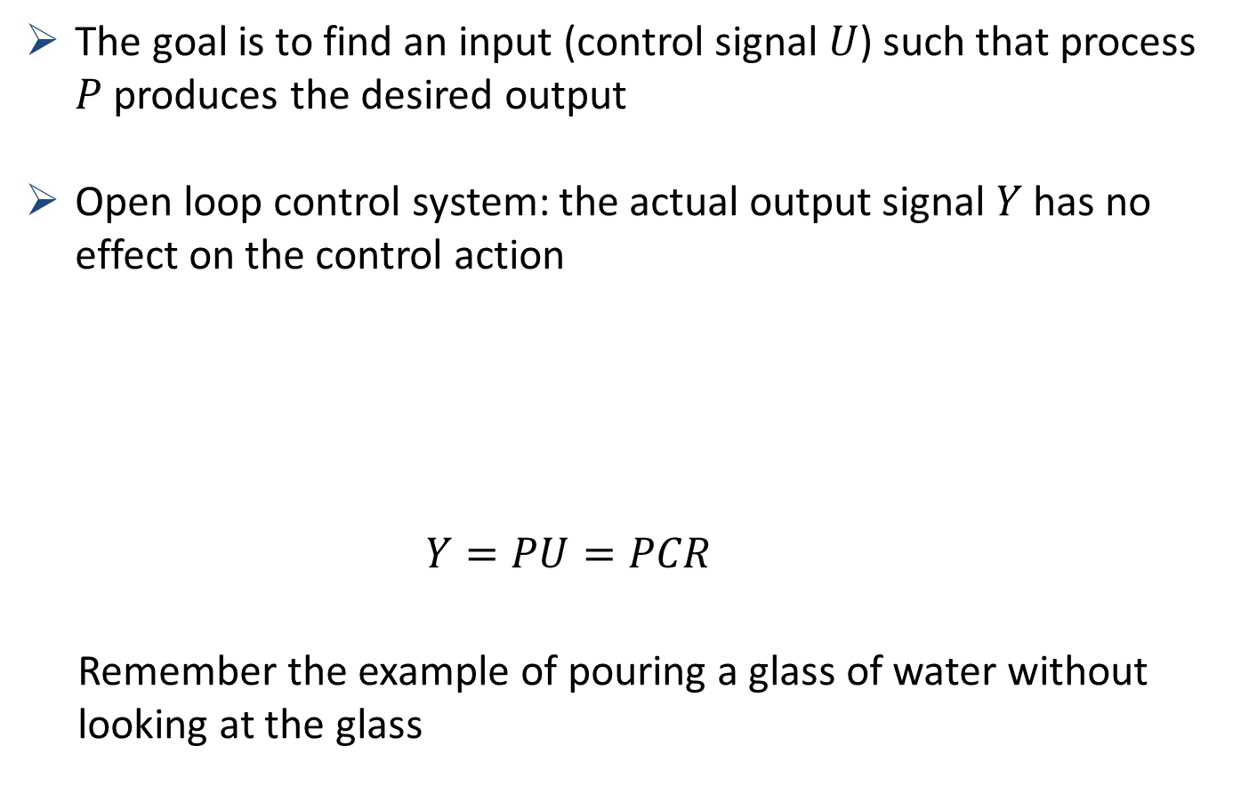
What is control?
The goal is to find an input (control signal $U$) such that process $P$ produces the desired output
Open loop control system: the actual output signal $Y$ has no effect on the control action
$Y=PU=PCR$
Remember the example of pouring a glass of water without looking at the glass

Slide 3

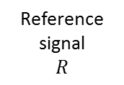
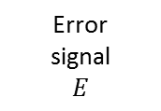
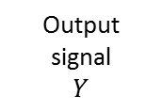
A general set-up of a closed loop system
We will focus on closed loop control systems
Example: Inverted pendulum
+
+
-1
Notes:
In a closed loop control system the actuating error signal $E$, which is the difference between the input signal $R$ (the desired output) and the feedback signal $Y$ (the actual output), is fed to the controller so as to reduce the error and bring the output of the system $P$ to a desired value.
Show example of inverted pendulum. Students can also play with this at home

Slide 4
But what is C
On-off controller
Thermostate at home
LTI-System (this course)
Cruise-control in your car
More advanced controllers exist

Slide 5
What is good control?
Before we will start to design control systems we will first focus on the question. What is good control?
It depends on the application
Stability
Disturbance rejection
Reference tracking (speed)
Sensitivity to errors on model
Etc...

Slide 6
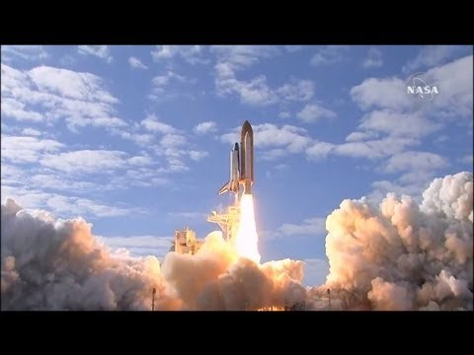
Examples (stability)
Space shuttles are like inverted pendulums. How do you make sure they don’t flip over.

Slide 7


Examples: Disturbance rejection
Your body will try to keep the temperature in your body as constant as possible. No matter what the outside temperature is. Two people will have almost the same body temperature.
Flickr.com
tent86
Marathon Des Sables 046
Jack Zalium
Enduring
https://creativecommons.org/licenses/by-nd/2.0/

Slide 8

Examples: reference tracking
Audi has a system for automatic driving in traffic jams. The audi will follow the car in front of him at an appropriate distance.
https://www.youtube.com/watch?v=Qa_ZSRj0WM0

Slide 9
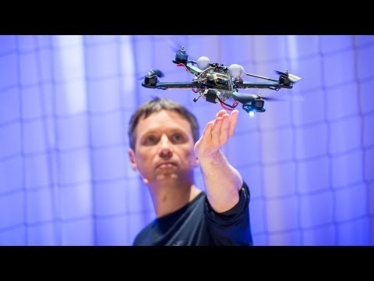
Exercise: name the correct property ...

Slide 10
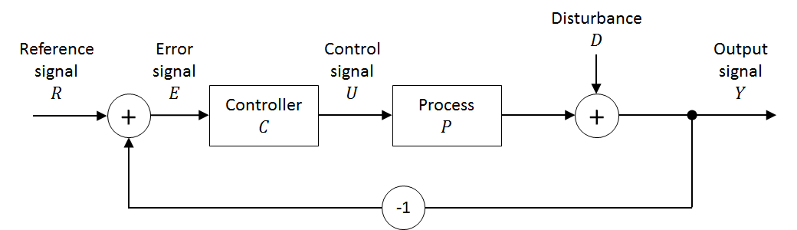
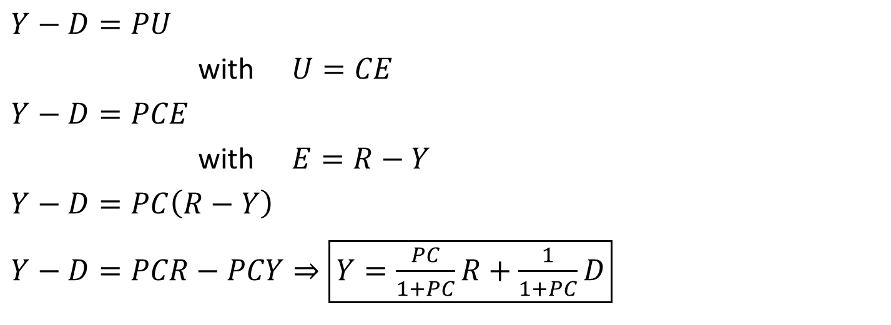
The transfer function from $R$ and $D$ to $Y$
$Y−D=PU$
with $U=CE$
$Y−D=PCE$
with $E=R−Y$
$Y−D=PC\left(R−Y\right)$
$Y−D=PCR−PCY⇒\boxed{Y=\frac{PC}{1+PC}R+\frac{1}{1+PC}D}$

Slide 11
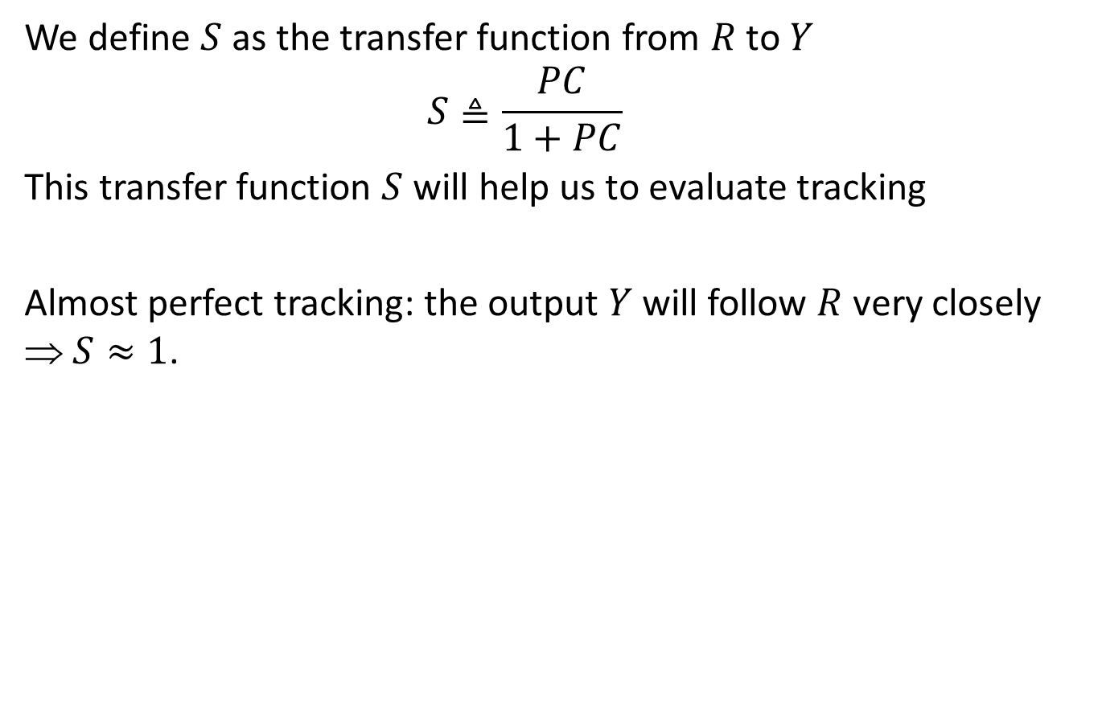
Transfer function from $R$ to $Y$
We define $S$ as the transfer function from $R$ to $Y$
$$S≜\frac{PC}{1+PC}$$
This transfer function $S$ will help us to evaluate tracking
Almost perfect tracking: the output $Y$ will follow $R$ very closely ⇒ $S≈1$.

Slide 12
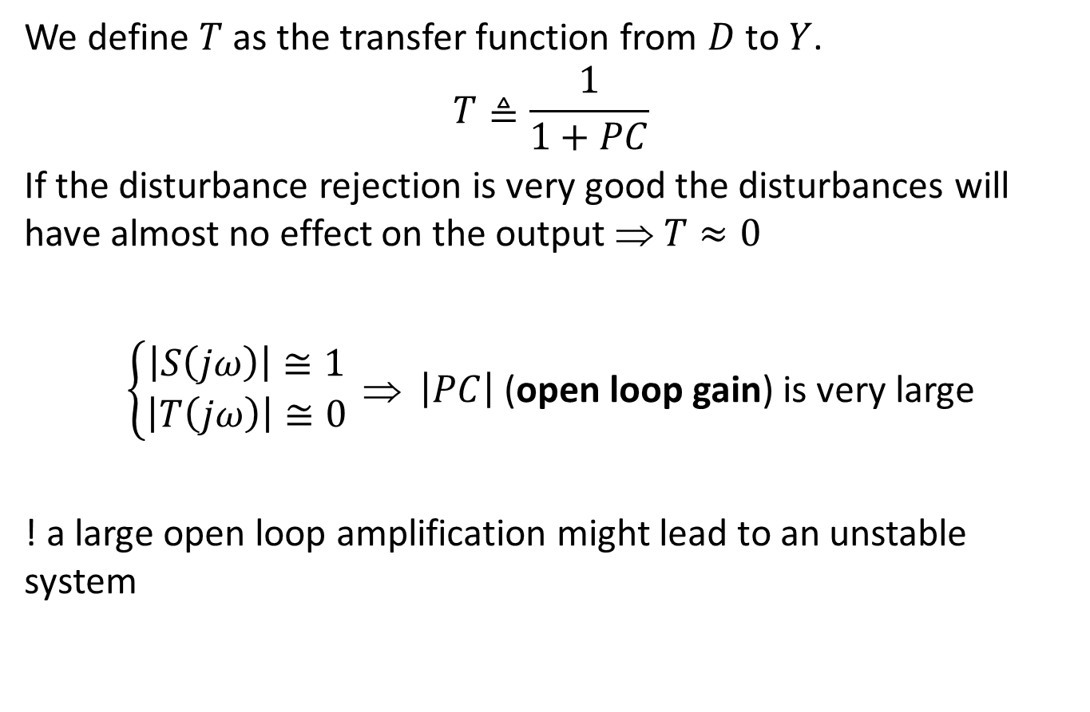
Transfer function from $D$ to $Y$
We define $T$ as the transfer function from $D$ to $Y$.
$$T≜\frac{1}{1+PC}$$
If the disturbance rejection is very good the disturbances will have almost no effect on the output ⇒ $T≈0$
$\left\{\begin{aligned}\left|S\left(jω\right)\right|≅1 \\ \left|T\left(jω\right)\right|≅0\end{aligned}\right. $ $\left|PC\right|$ (open loop gain) is very large
! a large open loop amplification might lead to an unstable system

Slide 13
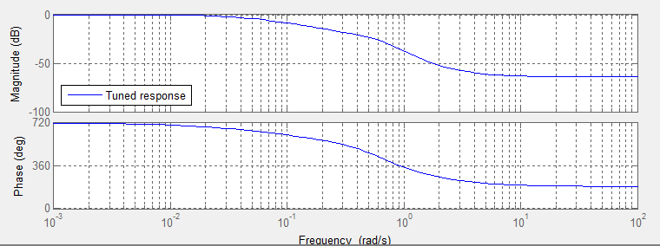
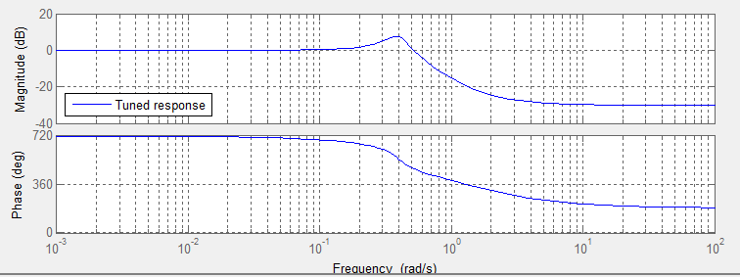
Example: Which controller do you prefer?
The transfer function from $R$ to $Y$ for two different controllers
First controller
Second Controller

Slide 14
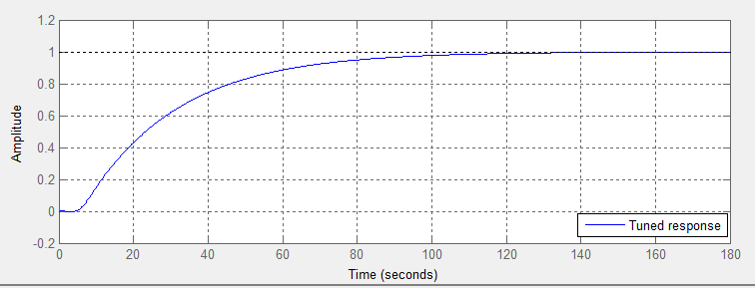
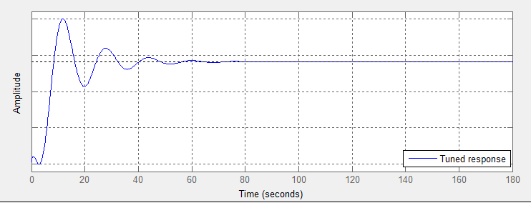
Example: step response of both controllers
The output $Y$ when a step is applied to $R$.
First controller
Second Controller

Slide 15
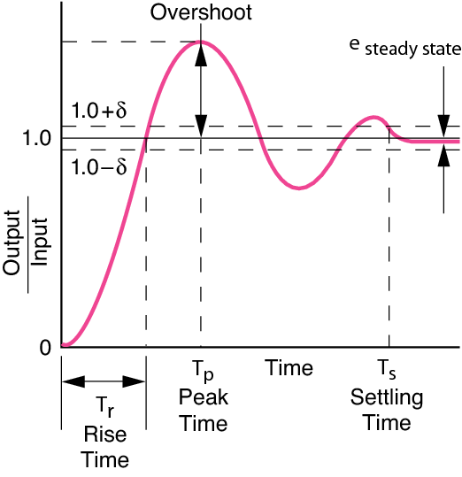

Quality of reference tracking
Look on the step response from $R$ to $Y$. All the known criteria can help you to decide the quality
Rise-time
Settling time
Steady state error
Overshoot
...
http://www.newport.com/Control-Theory-Terminology/178319/1033/content.aspx

Slide 16

Quality of reference tracking
Tracking bandwidth: The frequency range for which $S\left(jω\right)$ is close to $0 dB$.
Tracking bandwidth

Slide 17
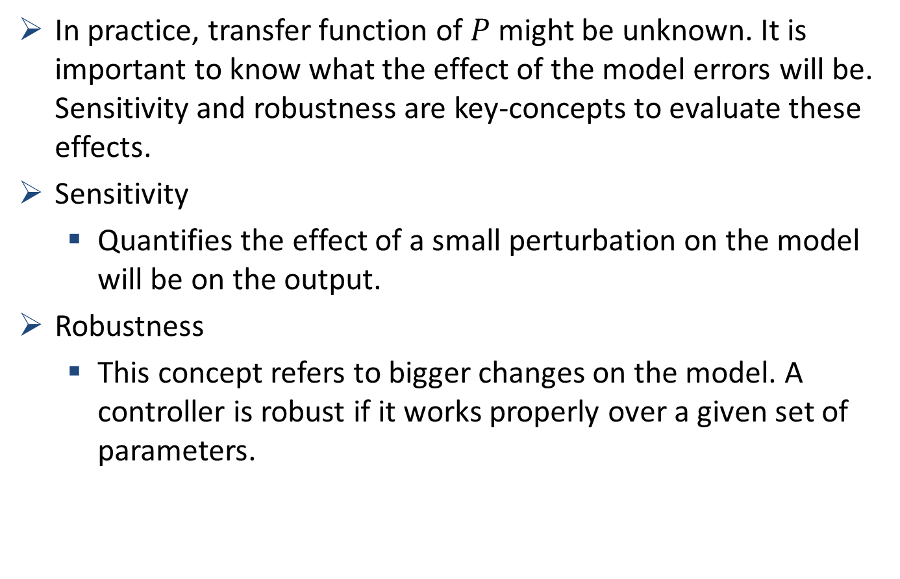
Model errors
In practice, transfer function of $P$ might be unknown. It is important to know what the effect of the model errors will be. Sensitivity and robustness are key-concepts to evaluate these effects.
Sensitivity
Quantifies the effect of a small perturbation on the model will be on the output.
Robustness
This concept refers to bigger changes on the model. A controller is robust if it works properly over a given set of parameters.

Slide 18
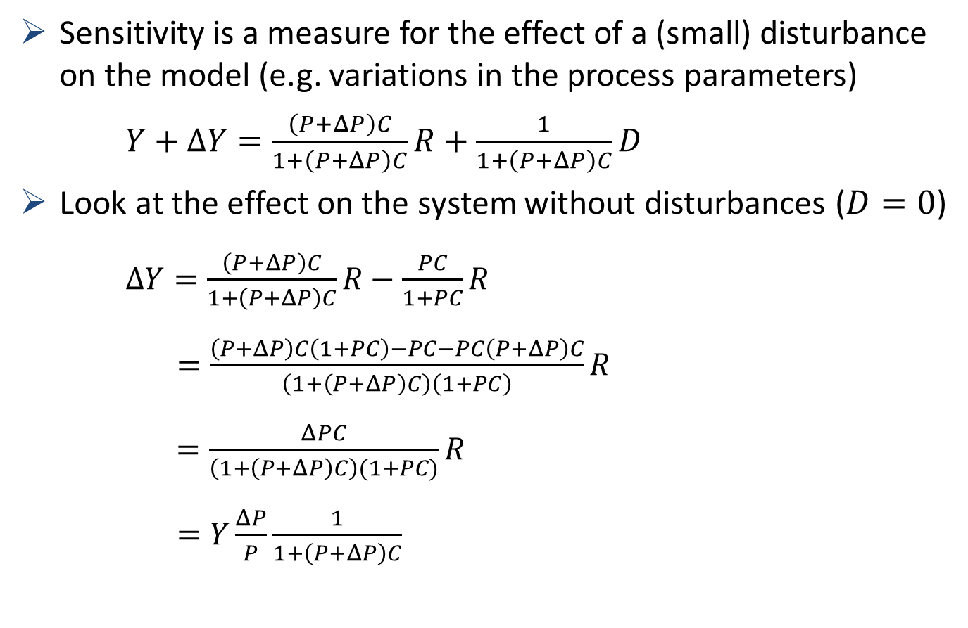
Sensitivity
Sensitivity is a measure for the effect of a (small) disturbance on the model (e.g. variations in the process parameters)
$Y+ΔY=\frac{\left(P+ΔP\right)C}{1+\left(P+ΔP\right)C}R+\frac{1}{1+\left(P+ΔP\right)C}D$
Look at the effect on the system without disturbances ($D=0$)
$ΔY=\frac{\left(P+ΔP\right)C}{1+\left(P+ΔP\right)C}R−\frac{PC}{1+PC}R$
$=\frac{\left(P+ΔP\right)C\left(1+PC\right)−PC−PC\left(P+ΔP\right)C}{\left(1+\left(P+ΔP\right)C\right)\left(1+PC\right)}R$
$=\frac{ΔPC}{\left(1+\left(P+ΔP\right)C\right)(1+PC)}R$
$=Y\frac{ΔP}{P}\frac{1}{1+\left(P+ΔP\right)C}$

Slide 19
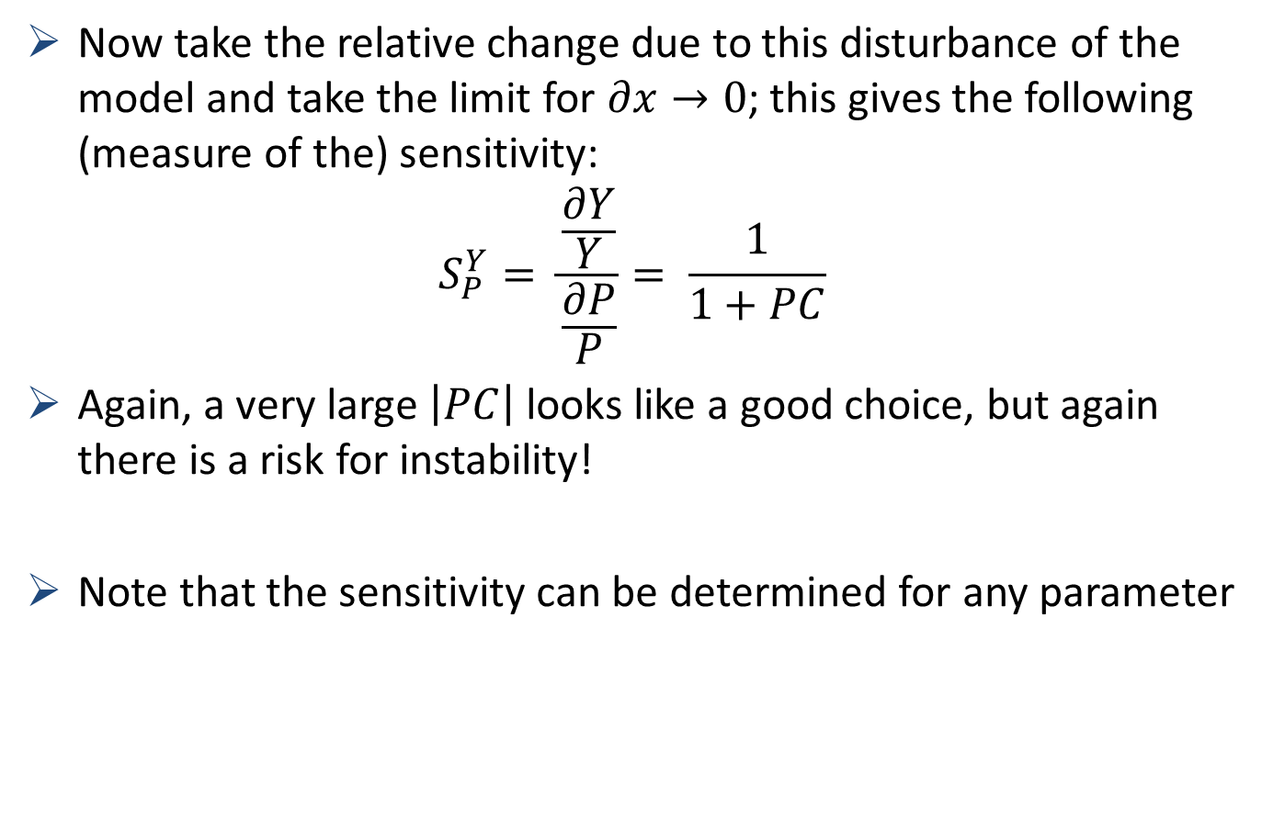
Sensitivity
Now take the relative change due to this disturbance of the model and take the limit for $∂x→0$; this gives the following (measure of the) sensitivity:
$$S_{P}^{Y}= \frac{\frac{∂Y}{Y}}{\frac{∂P}{P}}= \frac{1}{1+PC}$$
Again, a very large $\left|PC\right|$ looks like a good choice, but again there is a risk for instability!
Note that the sensitivity can be determined for any parameter

Slide 20
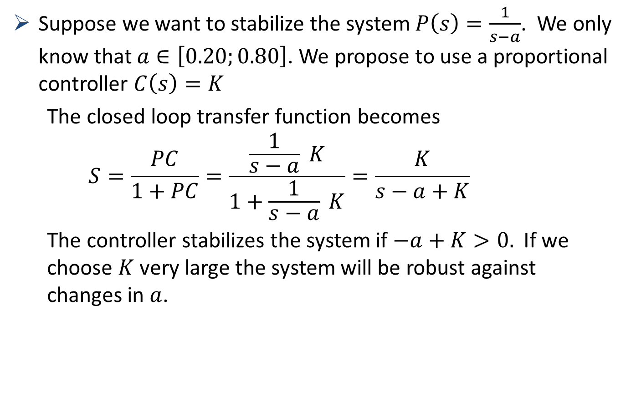
Example 1: robustness
Suppose we want to stabilize the system $P\left(s\right)=\frac{1}{s−a}$. We only know that $a∈\left[0.20;0.80\right]$. We propose to use a proportional controller $C\left(s\right)=K$
The closed loop transfer function becomes
$$S=\frac{PC}{1+PC}=\frac{\frac{1}{s−a} K}{1+\frac{1}{s−a} K}=\frac{K}{s−a+K}$$
The controller stabilizes the system if $−a+K>0.$ If we choose $K$ very large the system will be robust against changes in $a$.

Slide 21
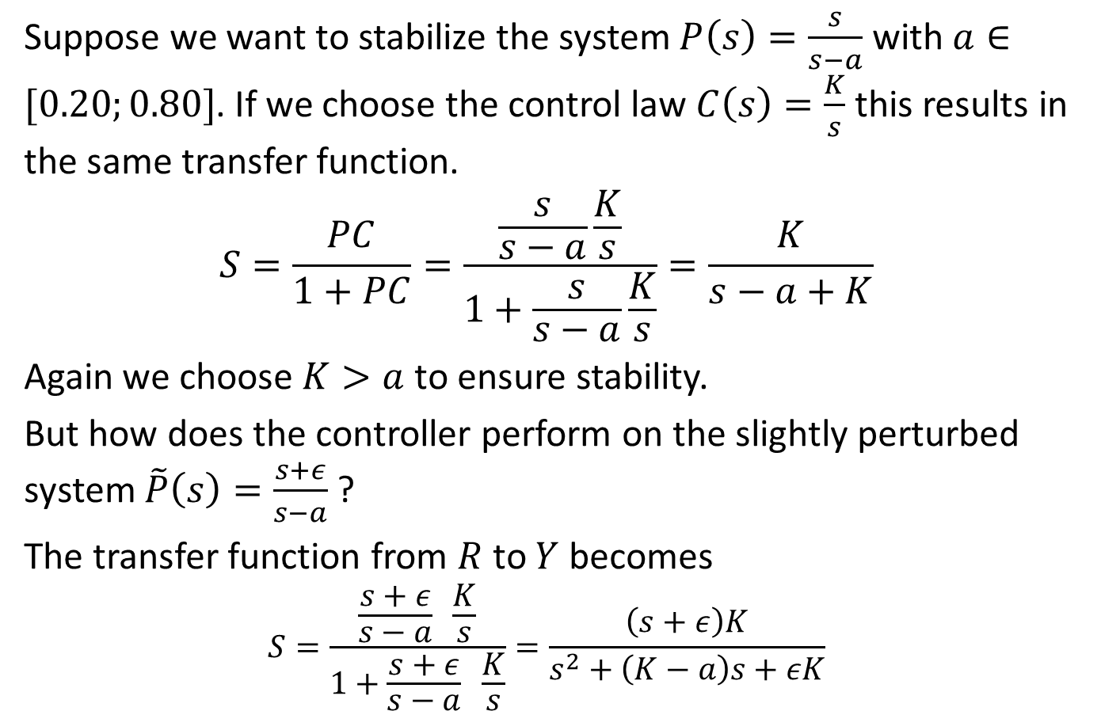
Example 2: robustness
Suppose we want to stabilize the system $P\left(s\right)=\frac{s}{s−a}$ with $a∈[0.20;0.80]$. If we choose the control law $C\left(s\right)=\frac{K}{s}$ this results in the same transfer function.
$$S=\frac{PC}{1+PC}=\frac{\frac{s}{s−a}\frac{K}{s}}{1+\frac{s}{s−a}\frac{K}{s}}=\frac{K}{s−a+K}$$
Again we choose $K>a$to ensure stability.
But how does the controller perform on the slightly perturbed system $\tilde{P}\left(s\right)=\frac{s+ε}{s−a}$?
The transfer function from $R$ to $Y$ becomes
$$S=\frac{\frac{s+ε}{s−a} \frac{K}{s}}{1+\frac{s+ε}{s−a} \frac{K}{s}}=\frac{\left(s+ε\right)K}{s^{2}+\left(K−a\right)s+εK}$$

Slide 22
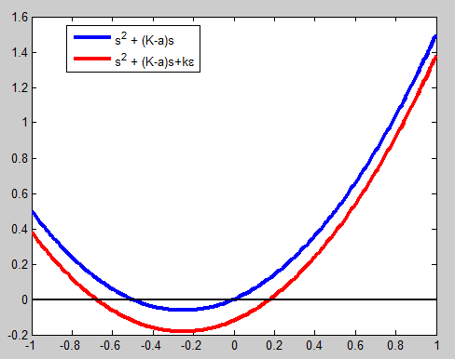
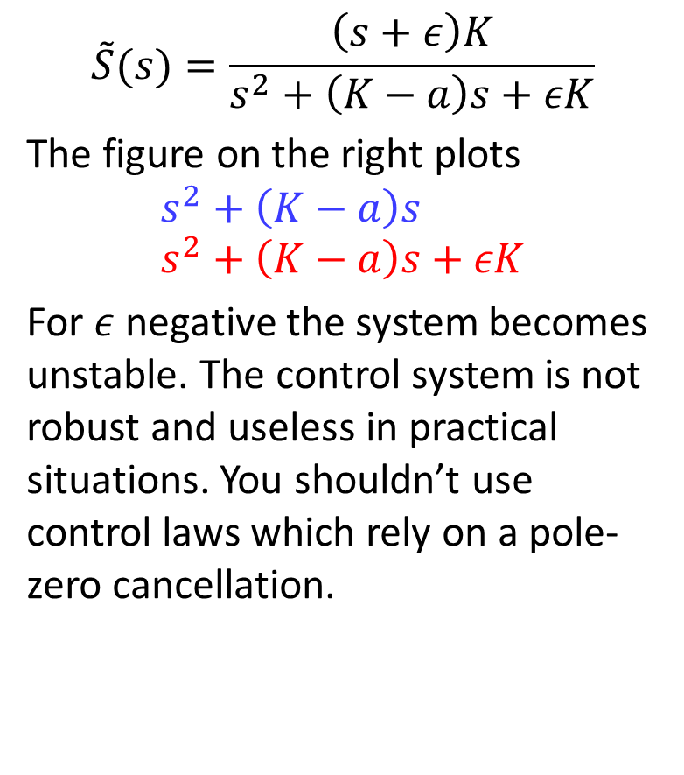
Example 2: robustness
$$\tilde{S}(s)=\frac{\left(s+ε\right)K}{s^{2}+\left(K−a\right)s+εK}$$
The figure on the right plots
$$s^{2}+\left(K−a\right)s \\ s^{2}+\left(K−a\right)s+εK$$
For $ε$ negative the system becomes unstable. The control system is not robust and useless in practical situations. You shouldn’t use control laws which rely on a pole-zero cancellation.
-K+a
0

Slide 23
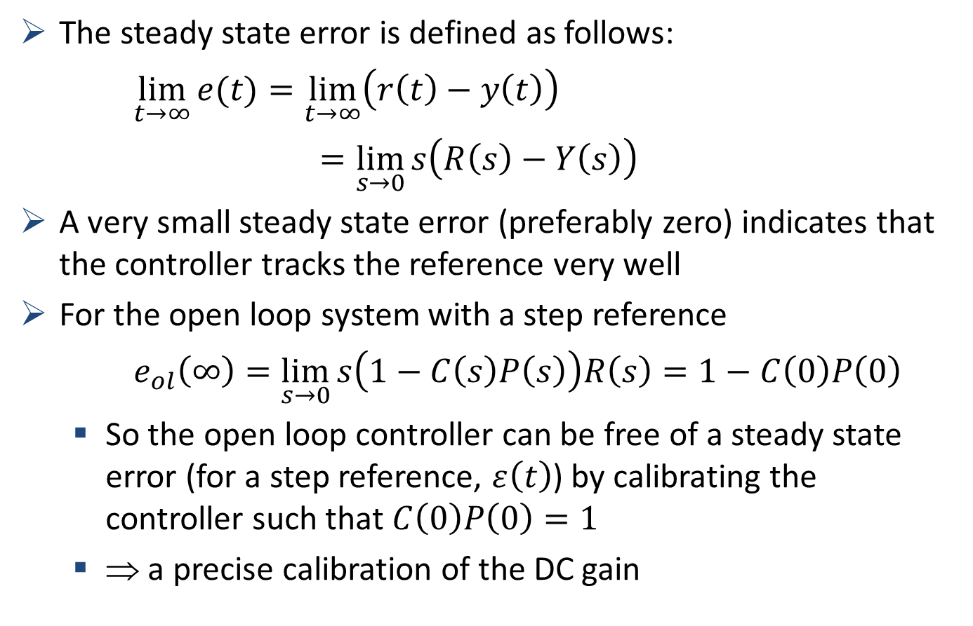
Example 3: Robustness of steady-state error
The steady state error is defined as follows:
$\lim_{t→∞}{e(t)}=\lim_{t→∞}\left(r\left(t\right)−y\left(t\right)\right)$
$=\lim_{s→0}{s\left(R\left(s\right)−Y\left(s\right)\right)}$
A very small steady state error (preferably zero) indicates that the controller tracks the reference very well
For the open loop system with a step reference
$e_{ol}\left(∞\right)=\lim_{s→0}{s\left(1−C\left(s\right)P\left(s\right)\right)R\left(s\right)=1−C\left(0\right)P\left(0\right)}$
So the open loop controller can be free of a steady state error (for a step reference, $ε\left(t\right)$) by calibrating the controller such that $C\left(0\right)P\left(0\right)=1$
⇒ a precise calibration of the DC gain
final value theorem

Slide 24
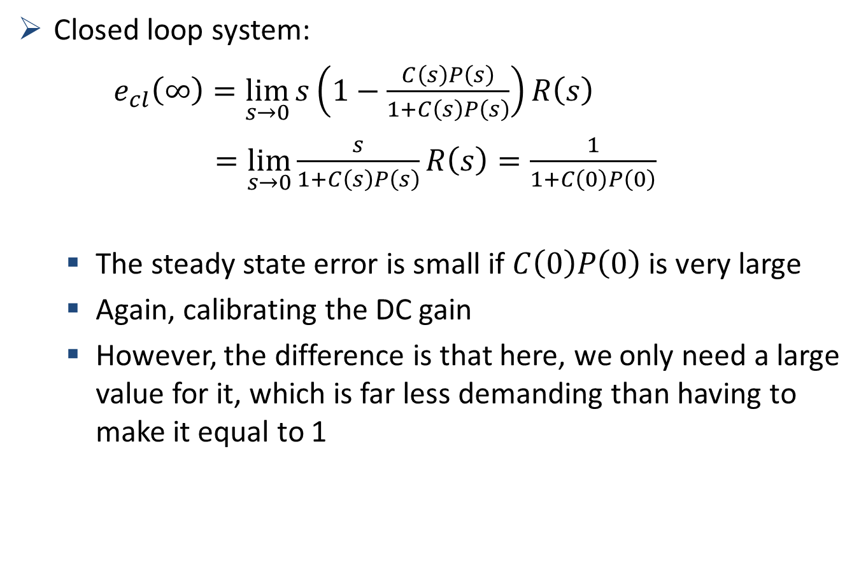
Example 3: Steady state error
Closed loop system:
$e_{cl}\left(∞\right)=\lim_{s→0}{s\left(1−\frac{C\left(s\right)P\left(s\right)}{1+C\left(s\right)P\left(s\right)}\right)R\left(s\right)}$
$=\lim_{s→0}{\frac{s}{1+C\left(s\right)P\left(s\right)}R\left(s\right)}=\frac{1}{1+C\left(0\right)P\left(0\right)}$
The steady state error is small if $C\left(0\right)P\left(0\right)$ is very large
Again, calibrating the DC gain
However, the difference is that here, we only need a large value for it, which is far less demanding than having to make it equal to 1

Slide 25
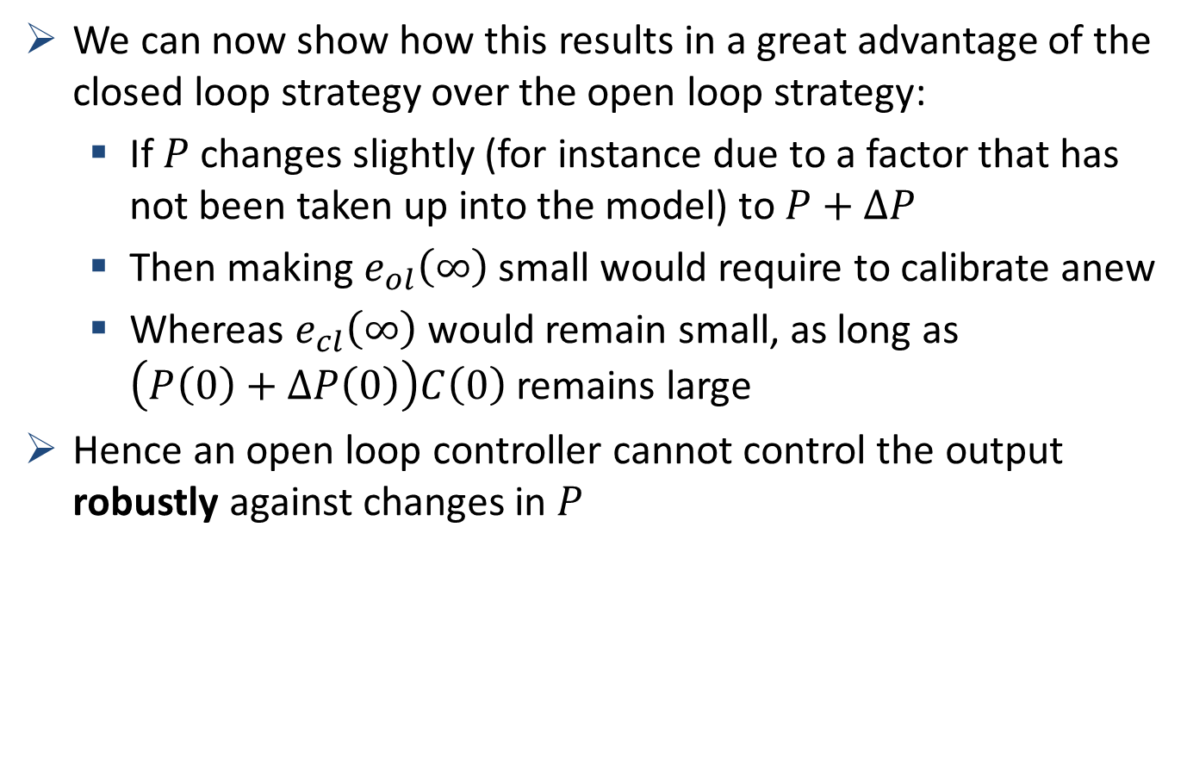
An open loop controller is not robust
We can now show how this results in a great advantage of the closed loop strategy over the open loop strategy:
If $P$ changes slightly (for instance due to a factor that has not been taken up into the model) to $P+∆P$
Then making $e_{ol}\left(∞\right)$ small would require to calibrate anew
Whereas $e_{cl}\left(∞\right)$ would remain small, as long as $\left(P\left(0\right)+∆P\left(0\right)\right)C\left(0\right)$ remains large
Hence an open loop controller cannot control the output robustly against changes in $P$

Slide 26
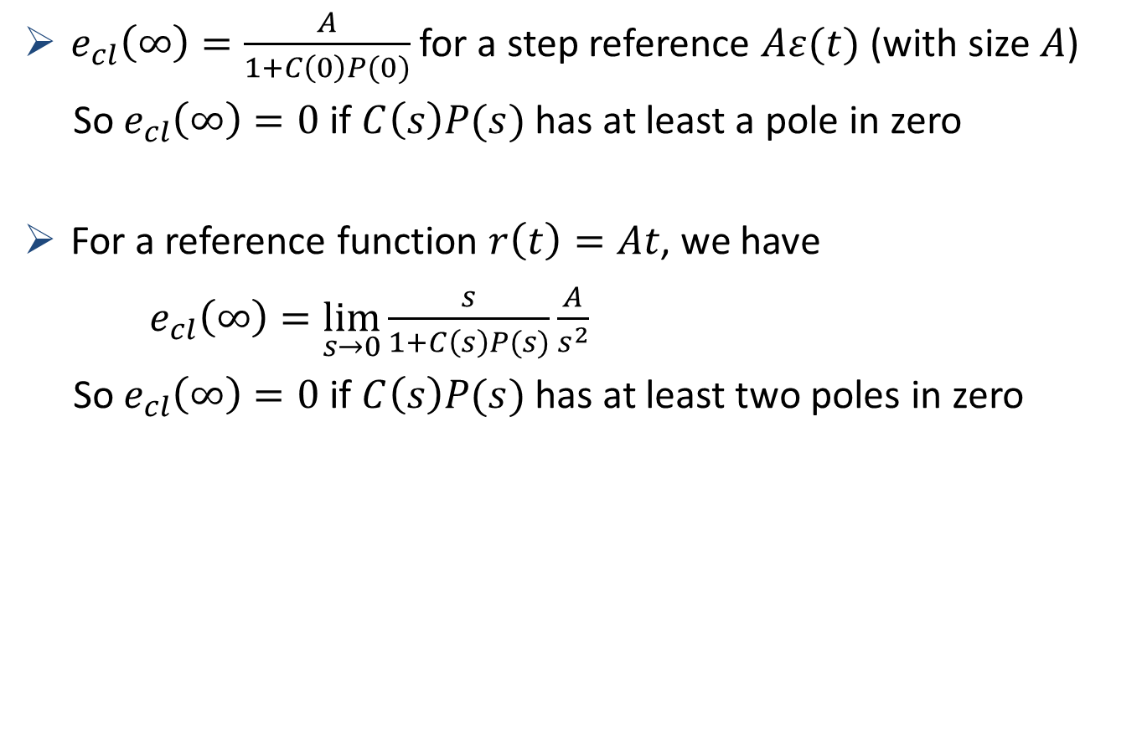
Type of a system
$e_{cl}\left(∞\right)=\frac{A}{1+C\left(0\right)P(0)}$ for a step reference $Aε(t)$ (with size $A$)
So $e_{cl}\left(∞\right)=0$ if $C\left(s\right)P(s)$ has at least a pole in zero
For a reference function $r\left(t\right)=At$, we have
$e_{cl}\left(∞\right)=\lim_{s→0}{\frac{s}{1+C\left(s\right)P(s)}\frac{A}{s^{2}}}$
So $e_{cl}\left(∞\right)=0$ if $C\left(s\right)P(s)$ has at least two poles in zero

Slide 27
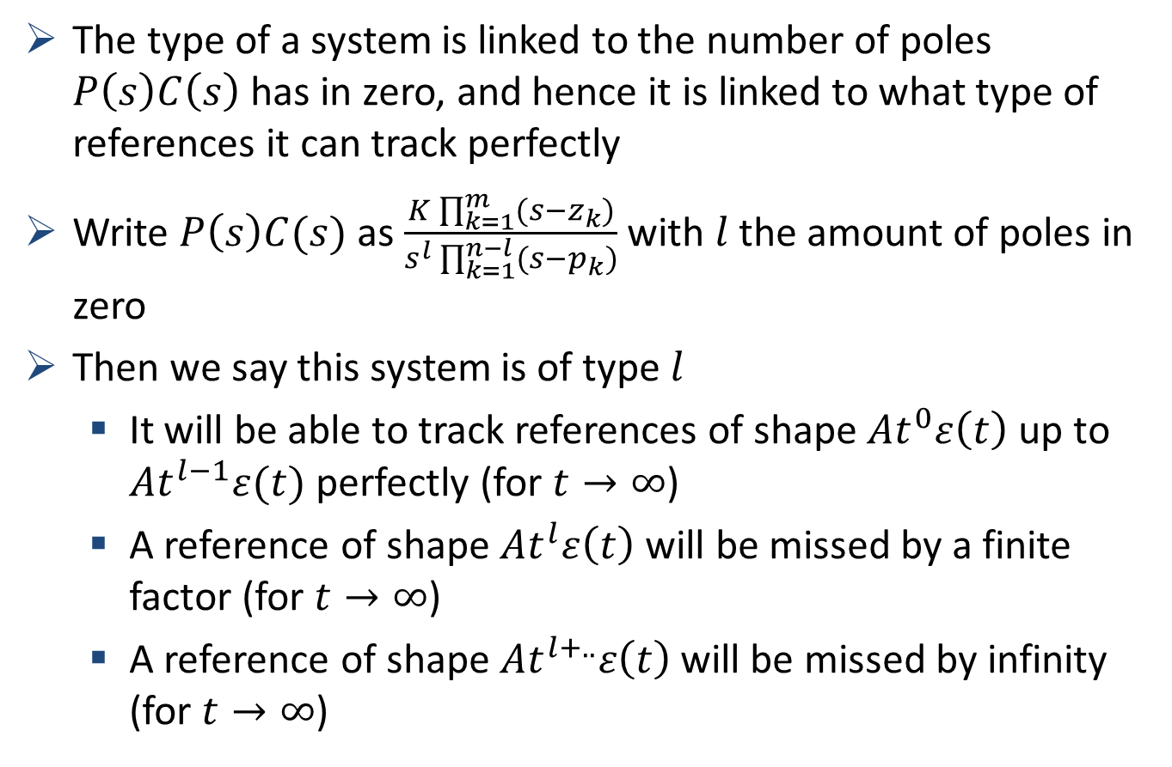
Type of a system
The type of a system is linked to the number of poles $P\left(s\right)C\left(s\right)$ has in zero, and hence it is linked to what type of references it can track perfectly
Write $P\left(s\right)C(s)$ as $\frac{K\prod_{k=1}^{m}{(s−z_{k})}}{s^{l}\prod_{k=1}^{n−l}{(s−p_{k})}}$ with $l$ the amount of poles in zero
Then we say this system is of type $l$
It will be able to track references of shape $At^{0}ε\left(t\right)$ up to $At^{l−1}ε(t)$ perfectly (for $t→∞$)
A reference of shape $At^{l}ε\left(t\right)$ will be missed by a finite factor (for $t→∞$)
A reference of shape $At^{l+..}ε\left(t\right)$will be missed by infinity (for $t→∞$)

Slide 28
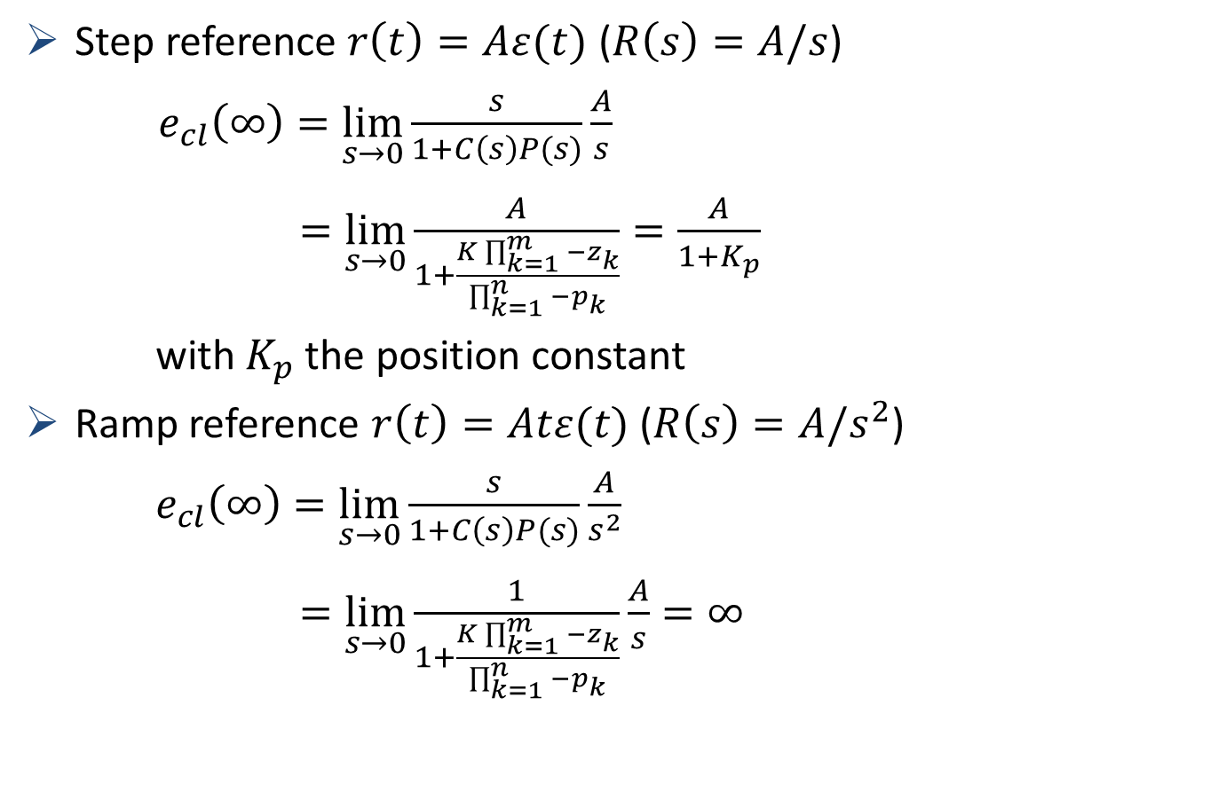
Example of a type 0 system
Step reference $r\left(t\right)=Aε(t)$ ($R\left(s\right)=A/s$)
$e_{cl}\left(∞\right)=\lim_{s→0}{\frac{s}{1+C\left(s\right)P(s)}\frac{A}{s}}$
$=\lim_{s→0}{\frac{A}{1+\frac{K\prod_{k=1}^{m}{−z_{k}}}{\prod_{k=1}^{n}{−p_{k}}}}}=\frac{A}{1+K_{p}}$
with $K_{p}$ the position constant
Ramp reference $r\left(t\right)=Atε(t)$ ($R\left(s\right)=A/s^{2}$)
$e_{cl}\left(∞\right)=\lim_{s→0}{\frac{s}{1+C\left(s\right)P(s)}\frac{A}{s^{2}}}$
$=\lim_{s→0}{\frac{1}{1+\frac{K\prod_{k=1}^{m}{−z_{k}}}{\prod_{k=1}^{n}{−p_{k}}}}}\frac{A}{s}=∞$

Slide 29
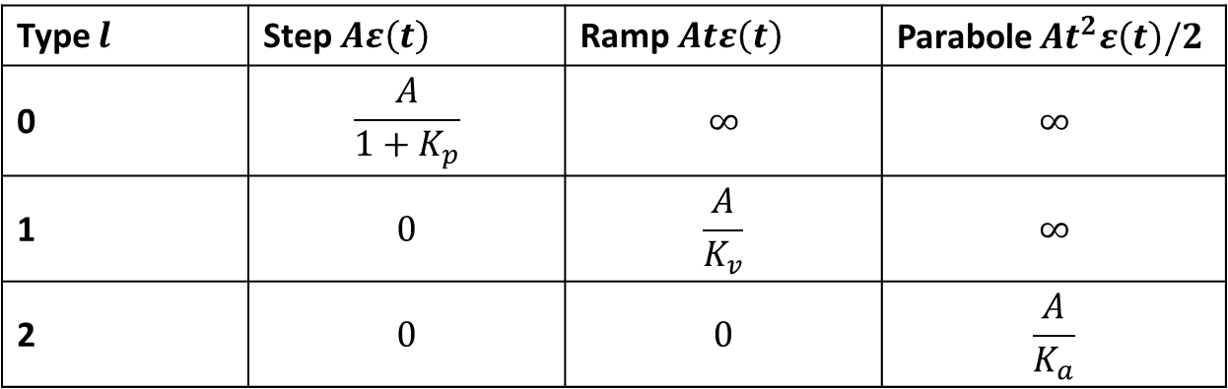

Steady state errors – type of a system
With:
$K_{p}=\lim_{s→0}\left(P\left(s\right)C\left(s\right)\right)$ $K_{p}$ = position constant
$K_{v}=\lim_{s→0}\left(sP\left(s\right)C\left(s\right)\right)$ $K_{v}$ = velocity constant
$K_{a}=\lim_{s→∞}\left(s^{2}P\left(s\right)C\left(s\right)\right)$ $K_{a}$ = acceleration constant
And the respective steady state errors are, for different system types:
Type $l$ | Step $Aε\left(t\right)$ | Ramp $Atε\left(t\right)$ | Parabole $At^{2}ε\left(t\right)/2$
0 | $$\frac{A}{1+K_{p}}$$ | $$∞$$ | $$∞$$
1 | $$0$$ | $$\frac{A}{K_{v}}$$ | $$∞$$
2 | $$0$$ | $$0$$ | $$\frac{A}{K_{a}}$$

Slide 30

Noise rejection and disturbance rejection
Both refer to rejection of the input $D$ but are not the same
Measurement noise is often modelled by white noise. (High frequency signal)
Disturbances are actual changes to the state of the system.
+
+
-1

Slide 31
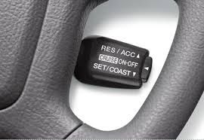
Noise versus Disturbances
Cruise control
Measurement errors on the speed are noise
A change in slope is a disturbance

Slide 32

Noise versus disturbance
Remember from the start of the lecture
$$Y=\frac{PC}{1+PC}R+\frac{1}{1+PC}D$$
Choosing $T=\frac{1}{1+PC}$ sufficiently small results in the rejection of D. This can be achieved by choosing $C$ sufficiently high.
+
+
-1

Slide 33
Disturbance versus noise
But what happens to measurement noise
The amplified measurement noise will be applied to the input of the plant.
In reality measurement noise requires no control actions. Good noise rejection means that the controller ignores this noise.
+
+
-1

Slide 34
Disturbance versus noise rejection
Good disturbance rejection requires fast action to bring the state back to the desired state
Good noise rejection requires that measurement noise will be ignored.
Note that a controller can not see the difference between measurement noise and disturbances. Slow controllers will be less sensitive to measurement noise. Fast system will have better disturbance rejection.

Slide 35
Classical trade-offs in control theory
Slow controllers
Not sensitive to noise
Small control inputs
Fast Controllers
Good disturbance rejection
Fast tracking
Robust controllers
Model errors will not affect the behaviour of the system strongly
Aggressive controllers
exchanges robustness for better performance

